Slide 1
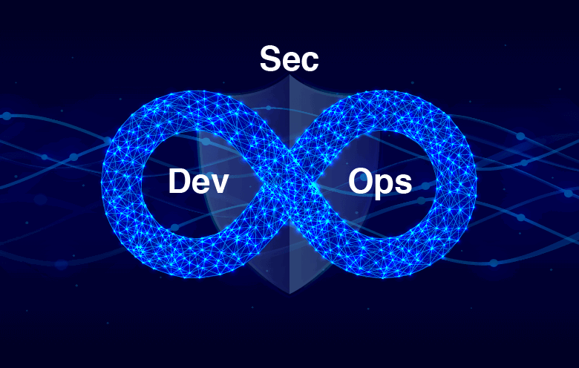
Modern Cryptography
24CYS206
Applied Cryptography
Dr.S.Udhayakumar
Associate Professor, AVV- Chennai

Slide 2
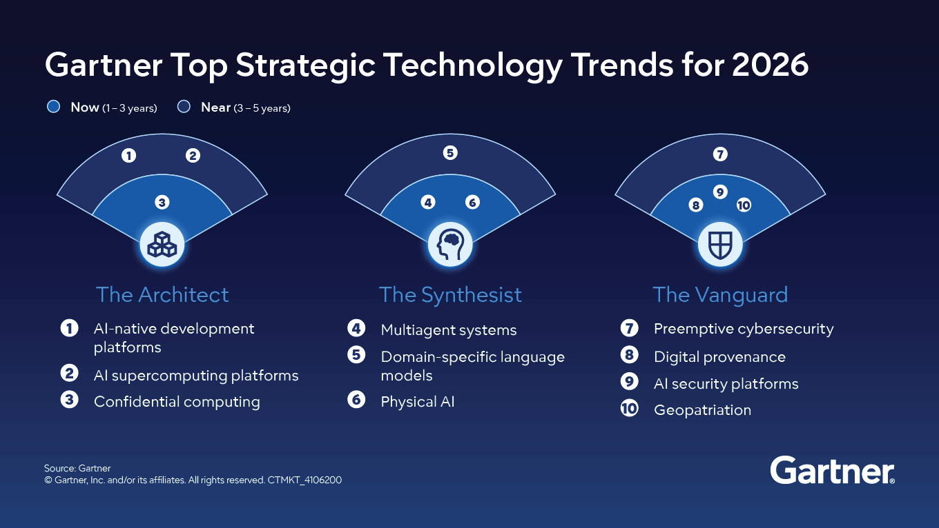
The 10 technology trends shaping the next five years
In 2026, disruption is accelerating and AI is no longer optional.

Slide 3
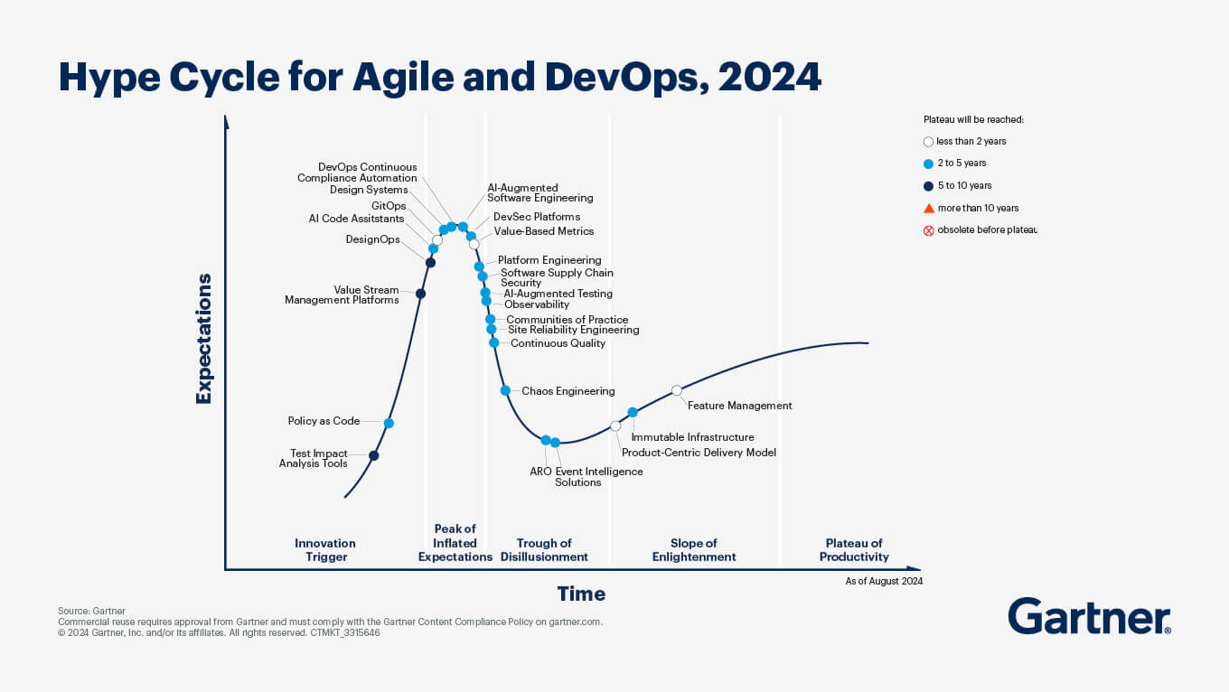

Slide 4
Course Description
This DevSecOps course provides a comprehensive deep dive into integrating security practices directly into the DevOps lifecycle to ensure faster, more secure software delivery. Participants will master the "Shift-Left" philosophy, learning to automate security testing using SAST, DAST, and SCA tools within CI/CD pipelines.
The curriculum covers managing Infrastructure as Code (IaC) securely and enforcing compliance through automated policy-driven frameworks like those taught in Practical DevSecOps programs.
Students will also gain hands-on experience in container security and real-time monitoring to proactively detect and mitigate production threats. Ultimately, the course empowers professionals to bridge the gap between development and security, fostering a culture of shared responsibility and continuous improvement.

Slide 5
Course Objective
Master Core Principles of DevSecOps: Understand the foundational concepts of DevSecOps, including the "Shift-Left" approach and how to foster a culture of shared responsibility between development, security, and operations teams.
Implement Automated Security Testing: Gain hands-on expertise in integrating security tools like SAST (Static Analysis), DAST (Dynamic Analysis), and SCA (Software Composition Analysis) directly into automated CI/CD pipelines.
Manage Security as Code: Learn to secure modern infrastructure by applying Infrastructure as Code (IaC) and Compliance as Code techniques using tools like Terraform, Ansible, and Chef Inspec.
Establish Continuous Monitoring and Response: Develop the skills to implement real-time security monitoring, logging, and automated alerting systems to proactively detect and mitigate threats in production.

Slide 6
Course Outcome
Construct Secure CI/CD Pipelines: Participants will be able to design and build end-to-end automated pipelines that integrate security gates, including SCA for third-party libraries and SAST/DAST for code and runtime analysis.
Implement Infrastructure and Compliance as Code: Graduates will be capable of using tools like Terraform or Ansible to provision hardened infrastructure and apply Compliance as Code to ensure continuous adherence to regulatory standards.
Execute Vulnerability Management and Mitigation: Students will demonstrate the ability to identify, prioritize, and remediate security flaws in applications and containers using tools like Snyk, Trivy, or DefectDojo.
Operationalize Continuous Security Monitoring: Participants will be able to set up real-time observability and alerting systems (e.g., ELK Stack or Nagios) to detect and respond to security incidents in live production environments.

Slide 7
Modules
Module 1: DevSecOps Fundamentals & Culture
Concepts: Introduction to the "Shift-Left" mindset, the CAMS model (Culture, Automation, Measurement, Sharing), and Secure SDLC principles.
Activity: Threat modeling (STRIDE/PASTA) and identifying security gates in a standard DevOps pipeline.
Module 2: Pipeline Security (CI/CD Automation)
Build Security: Integrating automated scanning into Jenkins, GitLab CI, or GitHub Actions.
Core Scanners:
SCA: Dependency scanning using Snyk or OWASP Dependency-Check.
SAST: Static code analysis with SonarQube or Bandit.
Secrets Management: Preventing sensitive data leaks using TruffleHog or HashiCorp Vault.
Module 3: Infrastructure as Code (IaC) & Cloud Security
Secure Provisioning: Hardening infrastructure scripts for Terraform, Ansible, or CloudFormation.
Compliance as Code: Automating regulatory checks (CIS benchmarks) using Inspec or OpenSCAP.
DAST Integration: Running dynamic runtime scans in staging using OWASP ZAP.
Module 4: Container & Orchestration Security
Container Hardening: Creating secure Dockerfiles and scanning images with Trivy or Clair.
Kubernetes Security: Managing RBAC, Network Policies, and cluster auditing with Kube-bench or Falco.
Module 5: Continuous Monitoring & Incident Response
Observability: Setting up centralized logging and monitoring with the ELK Stack (Elasticsearch, Logstash, Kibana) or Prometheus/Grafana.
Vulnerability Management: Centralizing findings in dashboards like DefectDojo to manage remediation workflows.

Slide 8
Featured Labs: Building a Secure Pipeline
Lab 1: Automated SAST with SonarQube Integrate SonarQube Server into a Jenkins pipeline to perform Static Application Security Testing. You will configure quality gates that automatically fail the build if high-severity vulnerabilities or "code smells" are detected.
Lab 2: Secrets Scanning with TruffleHog Configure TruffleHog or Gitrob as a pre-commit or build-stage check. You will intentionally "leak" a mock API key in a Git branch to verify that the tool detects and blocks the sensitive data from being pushed to the repository.
Lab 3: Container Vulnerability Scanning with Trivy Build a Docker image and use Trivy to scan it for known CVEs. You will then refactor the Dockerfile to use a hardened "distroless" base image to significantly reduce the attack surface.
Lab 4: Centralized Vulnerability Management with DefectDojo Export JSON scan results from various tools (SAST, DAST, SCA) and import them into DefectDojo. You will use the dashboard to de-duplicate findings and track the remediation lifecycle across different teams.

Slide 9
References
https://rupokify.com/tutorials/devops/jenkins-ci-cd-pipeline-sast-dast-docker-python/
https://aws.amazon.com/blogs/devops/building-end-to-end-aws-devsecops-ci-cd-pipeline-with-open-source-sca-sast-and-dast-tools/
https://neha1302.hashnode.dev/devsecops-cicd-pipeline
https://youtu.be/RwIhQg7Gxz0 Devops 11 hours of video from simplilearn
https://princepatni.com/blog/tech/what-is-devops-devops-engineer-roles-skills-courses-certification/

Slide 10
Software Development Life Cycle

Slide 11
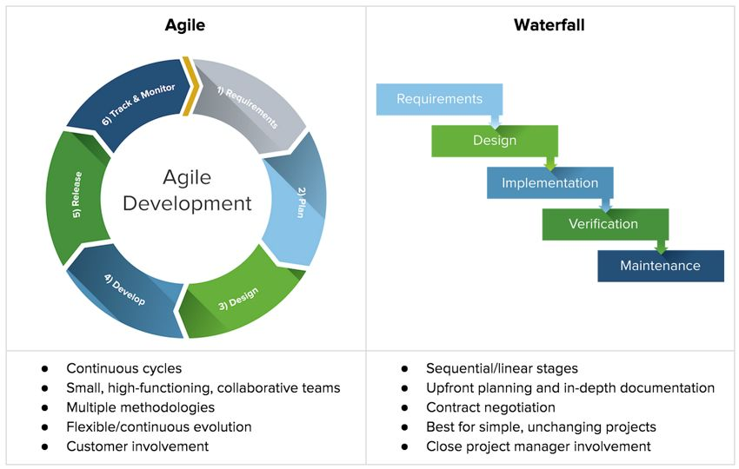
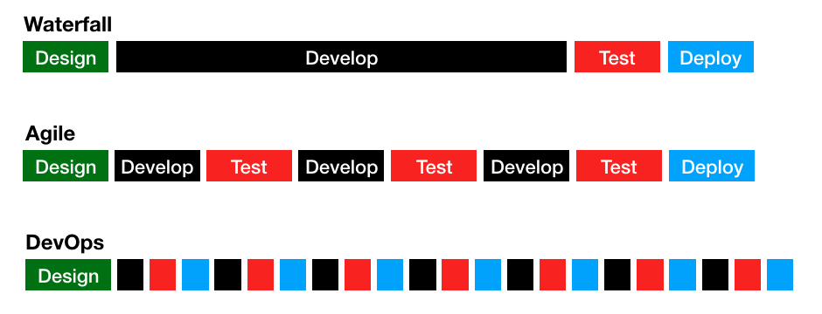

Slide 12
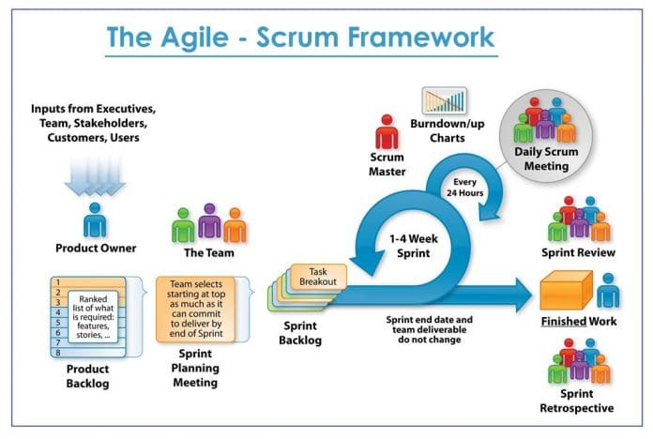

Slide 13
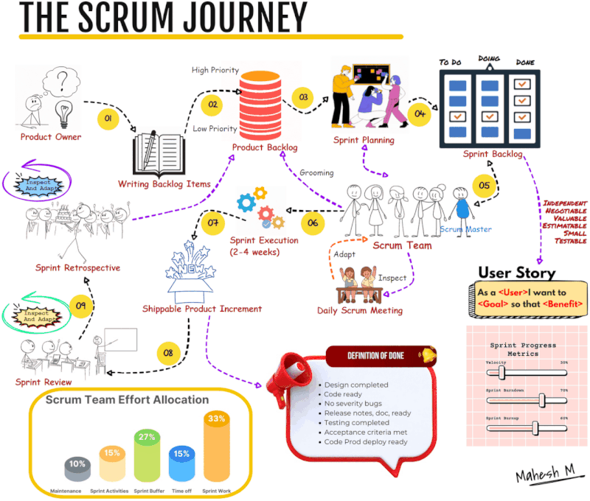

Slide 14
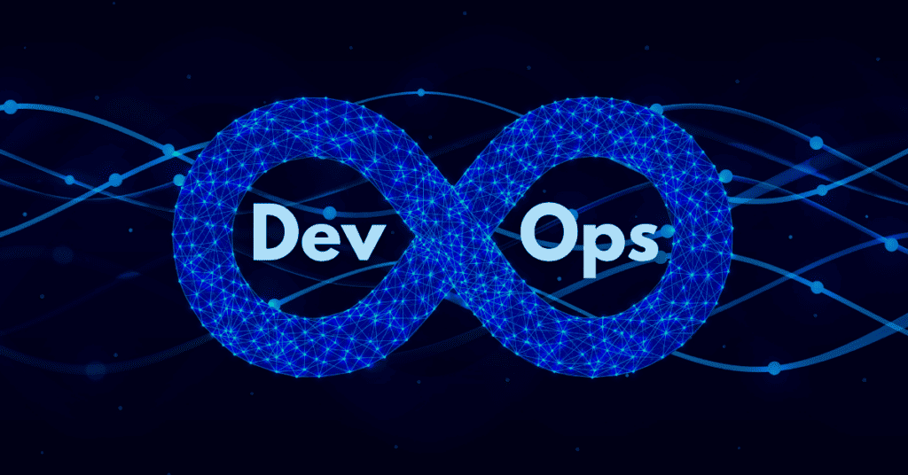

Slide 15
Introduction to DevOps
“DevOps is a set of practices that combines software development (Dev) and IT operations (Ops).
It aims to shorten the systems development life cycle and provide continuous delivery with high software quality.
DevOps is complementary with Agile software development; several DevOps aspects came from Agile methodology.”
AND
“a set of practices intended to reduce the time between committing a change to a system and the change being placed into normal production, while ensuring high quality”

Slide 16
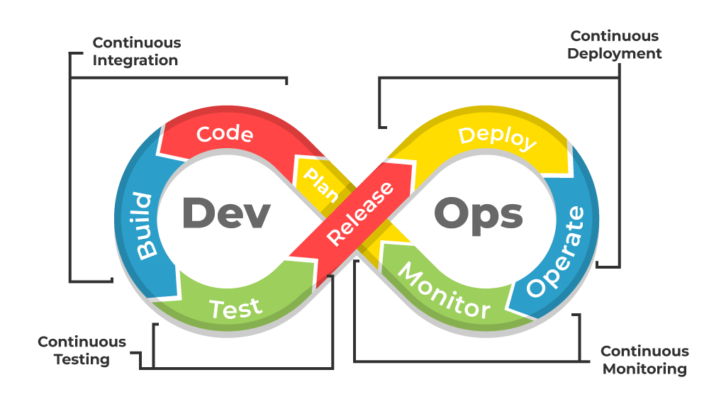
Introduction to DevOps
Source Code Management (Version Control): Developers commit code to shared repositories (e.g., GitHub, GitLab), triggering the pipeline.
Continuous Integration (CI): Code changes are automatically built and tested to detect issues early, ensuring code quality.
Continuous Testing (CT): Automated tests are run to validate functionality and security, preventing bugs from reaching production.
Continuous Delivery/Deployment (CD): Validated code is automatically deployed to staging or production environments, allowing for frequent, low-risk releases.
Continuous Monitoring: Production environments are continuously monitored to provide immediate feedback on performance and stability.

Slide 17
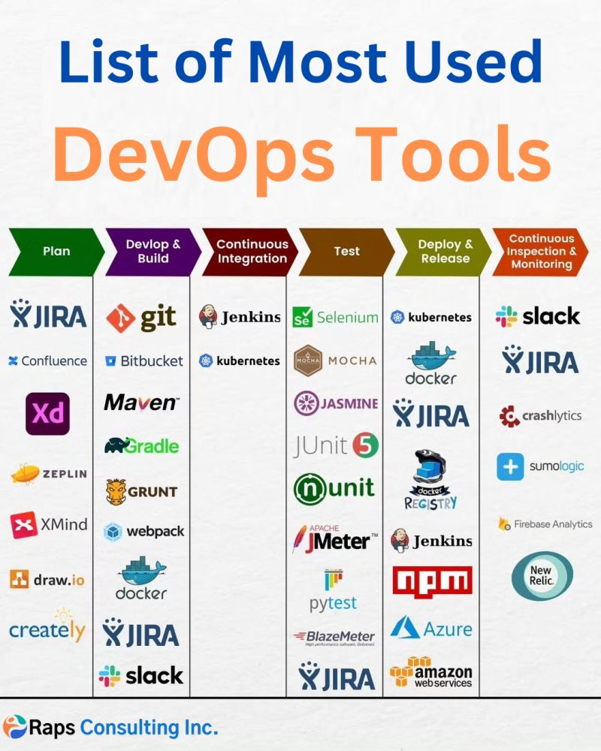

Only 6 tools DevOps is easy

Slide 18
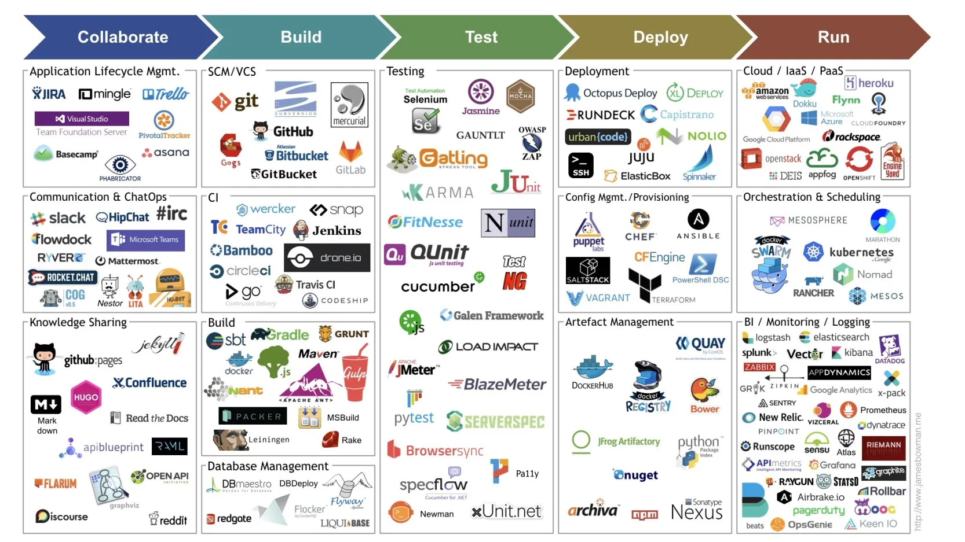

Slide 19
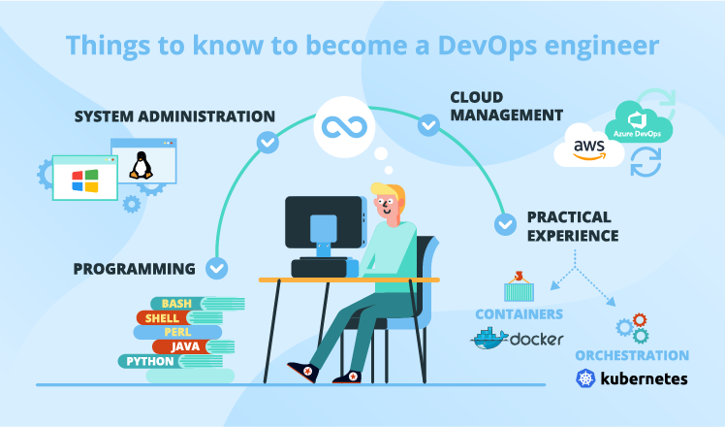

Slide 20



DevOps Stage 1: Plan

Slide 21
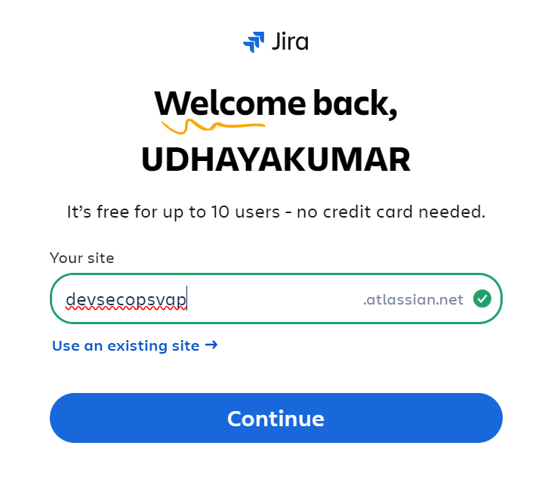
Planning with Atlassian's Jira
Atlassian Jira is a premier, highly customizable project management tool designed for tracking, agile software development, and workflow automation.
It acts as a central hub for planning, organizing, and delivering projects, using "issues" to track tasks, bugs, and user stories through customized Kanban or Scrum boards.

Slide 22
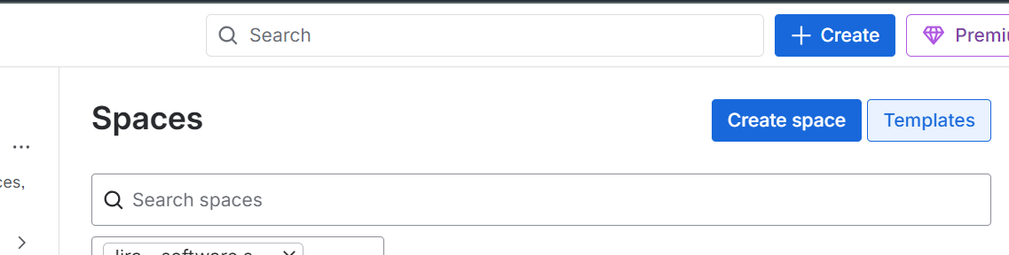
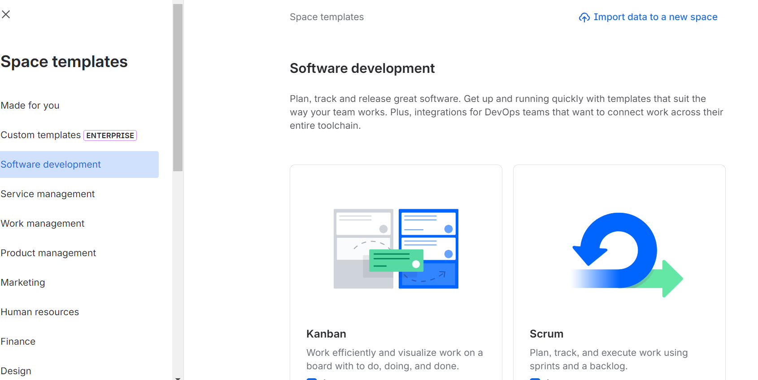
Select Scurm and proceed with UseTemplate

Slide 23
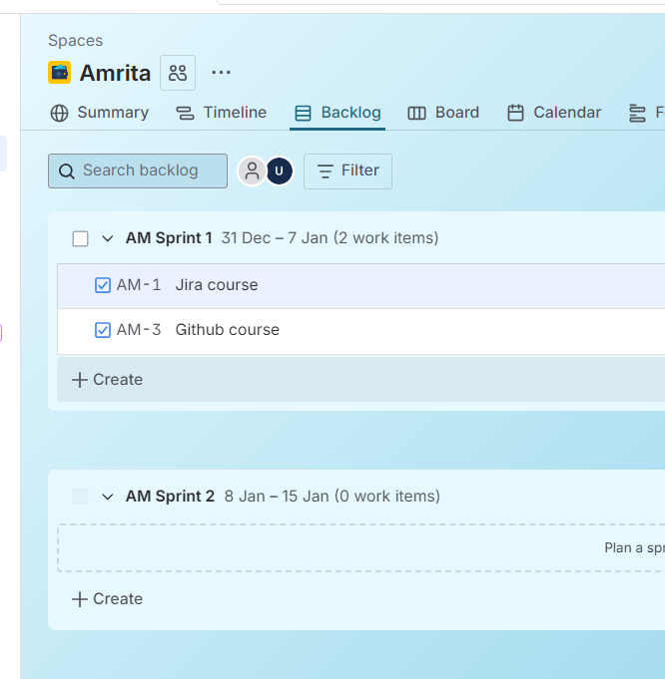
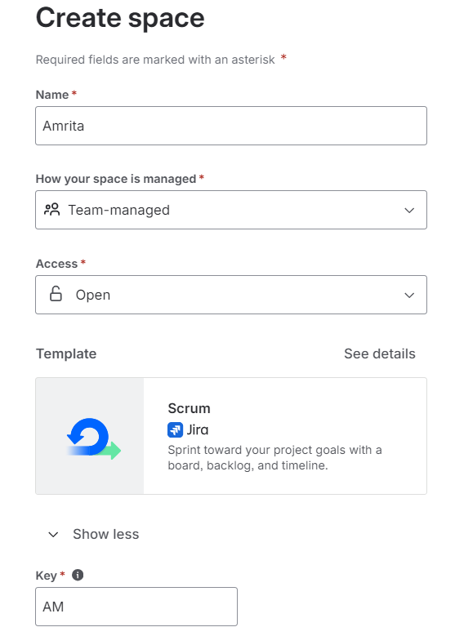
S/w Development → SCRUM → Use template→ Create Space
In the dashboard… use Backlog to create Sprint

Slide 24
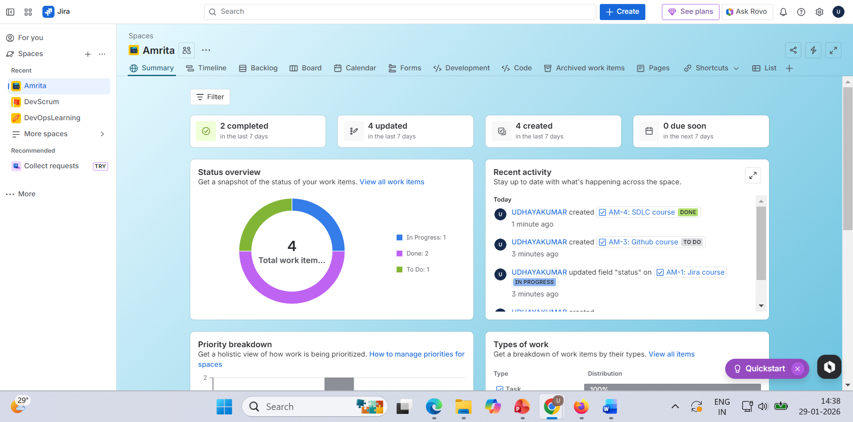

Slide 25
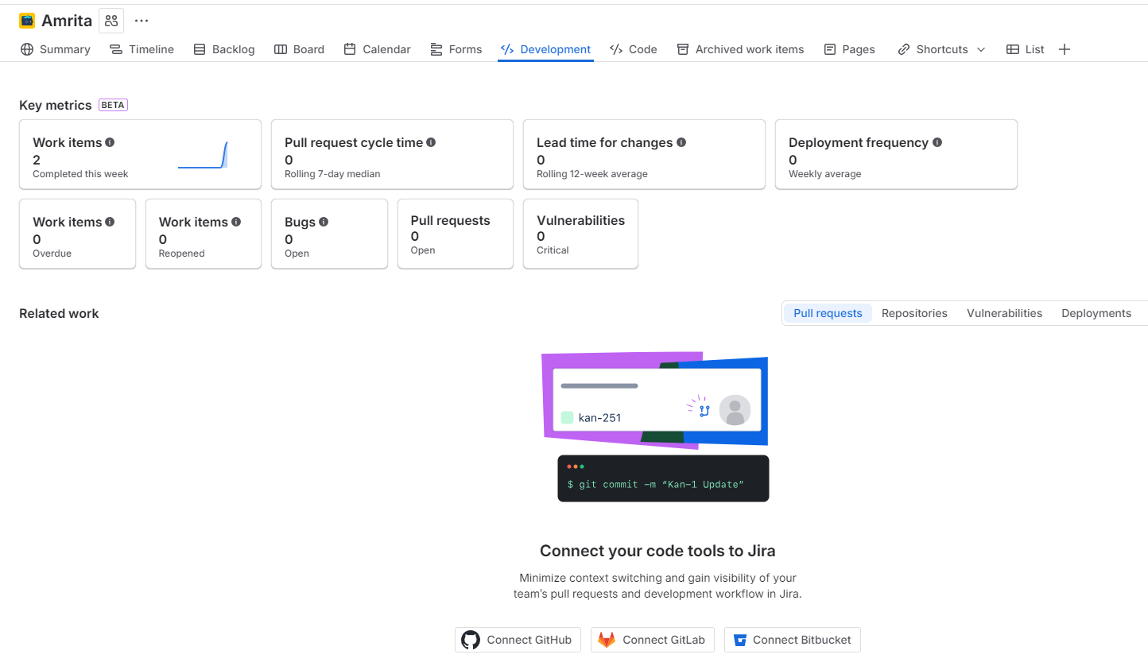
Coding starts

Slide 26


DevOps Stage 2: Develop and Build

Slide 27
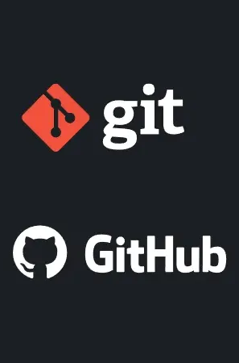
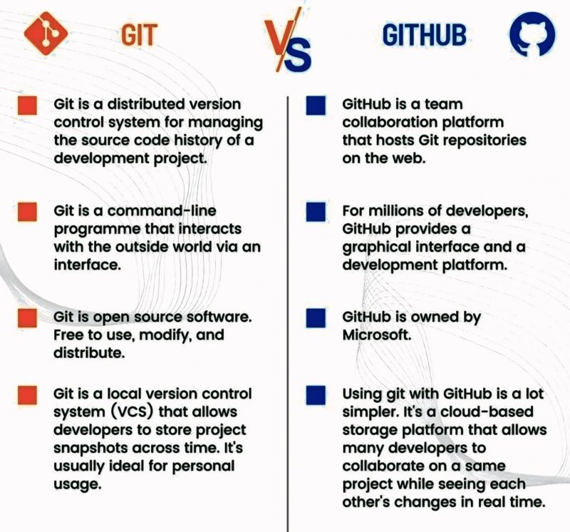

Slide 28
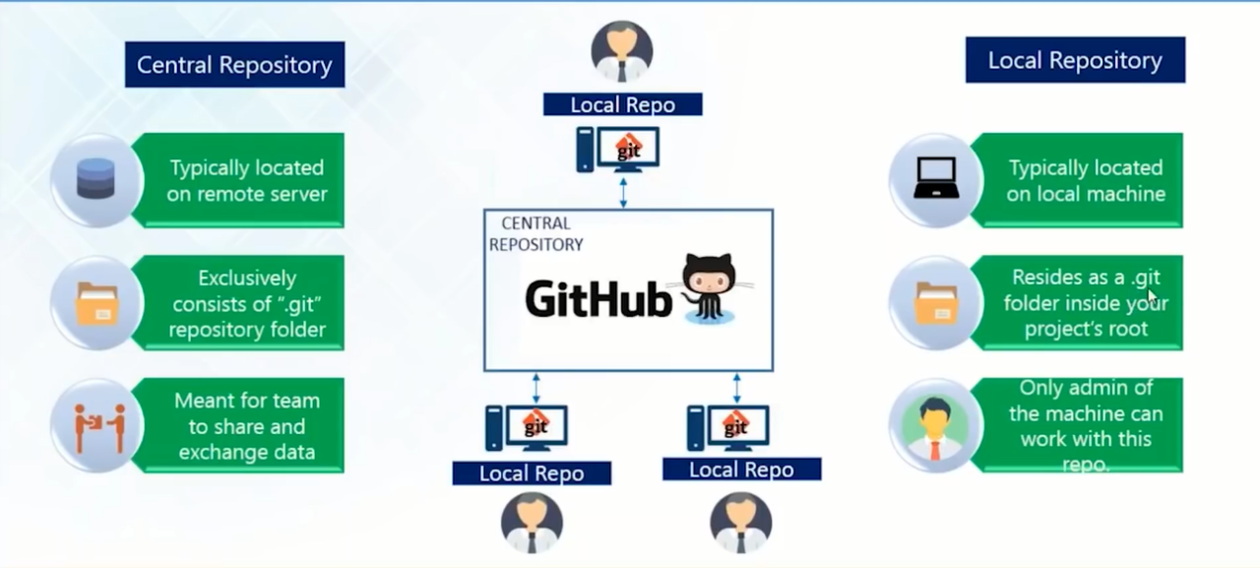

Slide 29
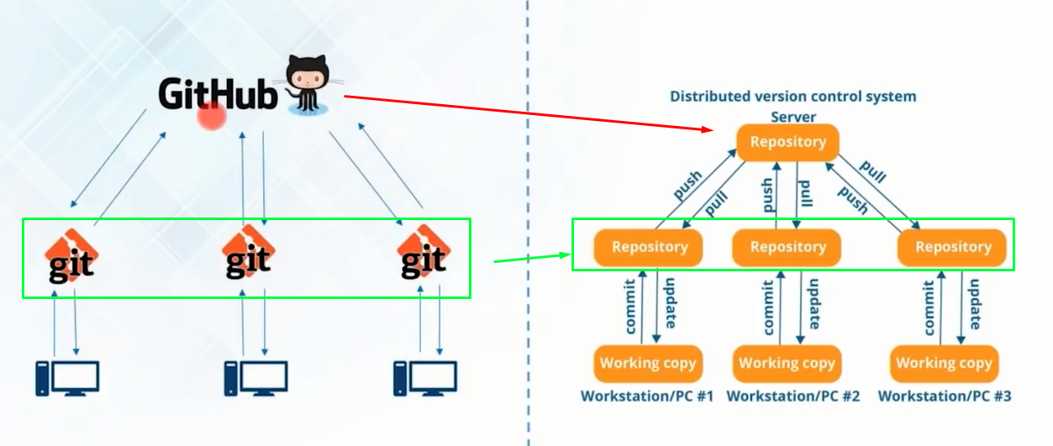
Git and GitHub working together for VCS

Slide 30
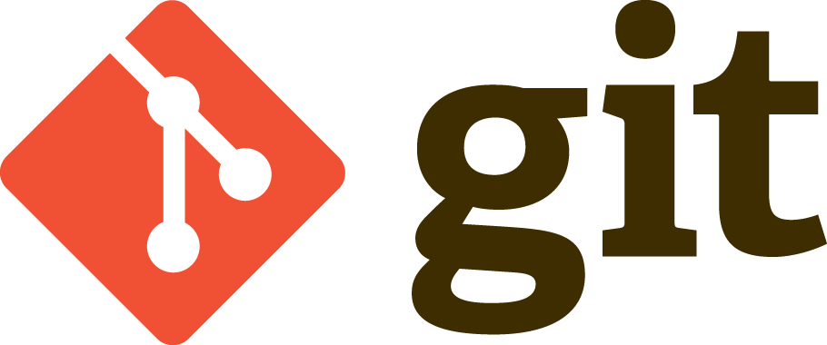

Slide 31
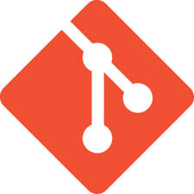
Introduction to Git
How it works?
Nearly Every Operation Is Local:
Most operations in Git need only local files and resources to operate
you have the entire history of the project right there on your local disk, most operations seem almost instantaneous
Git Has Integrity
Everything in Git is check-summed before it is stored and is then referred to by that checksum
You can’t lose information in transit or get file corruption without Git being able to detect it.
Git Generally Only Adds Data
When you do actions in Git, nearly all of them only add data to the Git database
After you commit a snapshot into Git, it is very difficult to lose, especially if you regularly push your database to another repository

Slide 32
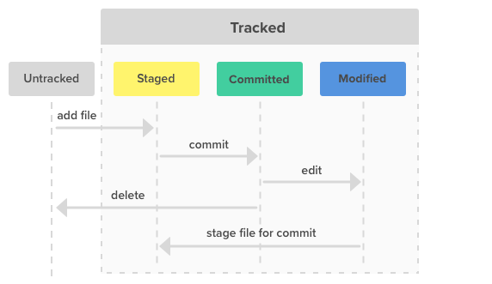
States of Git
The three states of Git
Git has three main states that your files can reside in:
Committed : Committed means that the data is safely stored in your local database
Modified : Modified means that you have changed the file but have not committed it to your database yet.
Staged : Staged means that you have marked a modified file in its current version to go into your next commit snapshot.

Slide 33
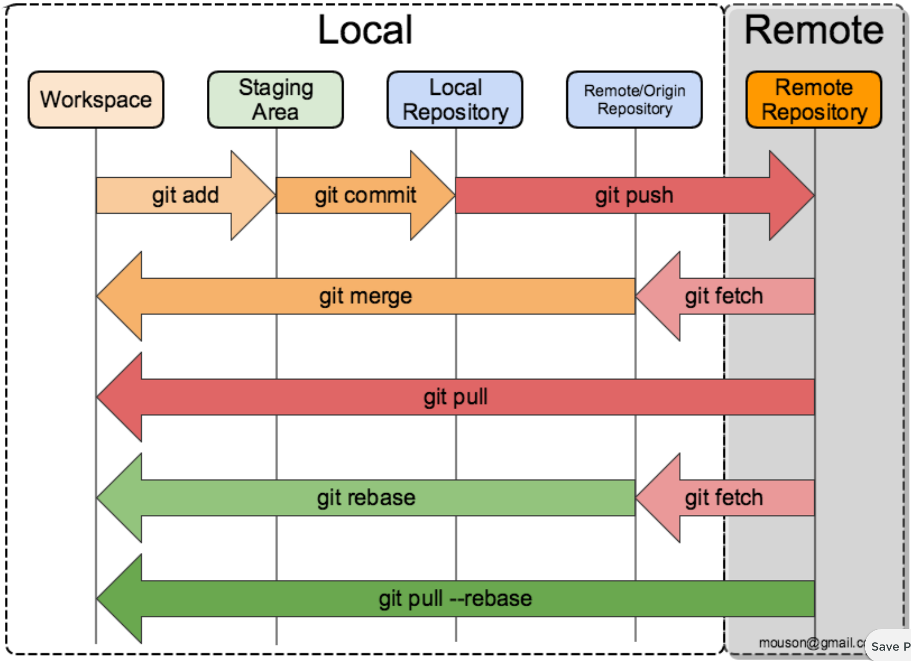
A Git Project
A Git Project will have
The Git directory:
It is where Git stores the metadata and object database for your project
It is copied when you clone a repository from another computer
The working tree:
It is a single checkout of one version of the project
These files are pulled out of the compressed database in the Git directory and placed on disk for you to use or modify
The staging area:
It is a file, generally contained in your Git directory
It stores information about what will go into your next commit

Slide 34
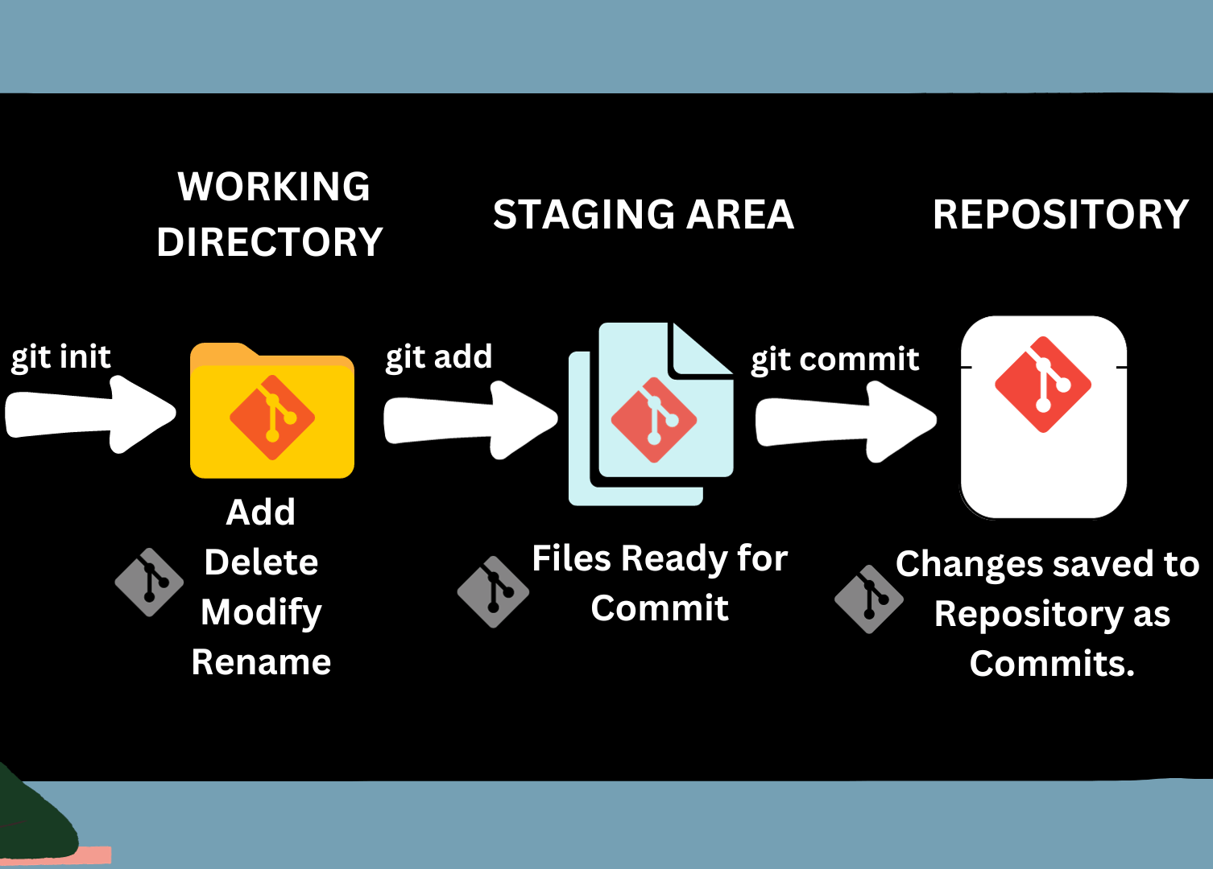
Git workflow
The basic Git workflow
You modify files in your working tree
You selectively stage just those changes you want to be part of your next commit; which adds only those changes to the staging area.
You do a commit; which takes the files as they are in the staging area and stores that snapshot permanently to your Git directory.

Slide 35
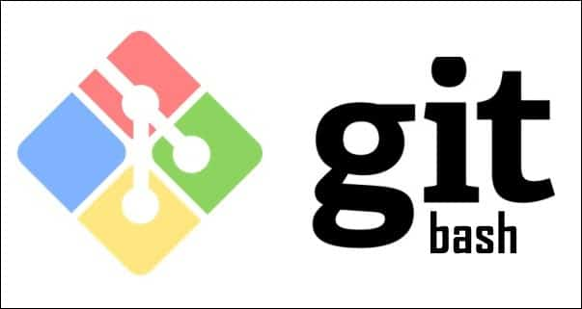
BASIC COMMANDS

Slide 36
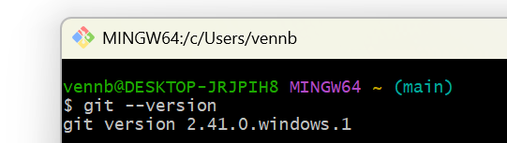
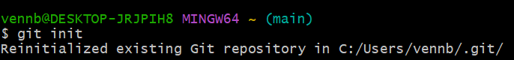
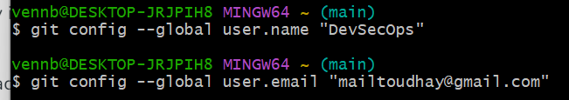
Open Git bash
1. Git Version
2. Git Initialize
2. Git Configuration

Slide 37
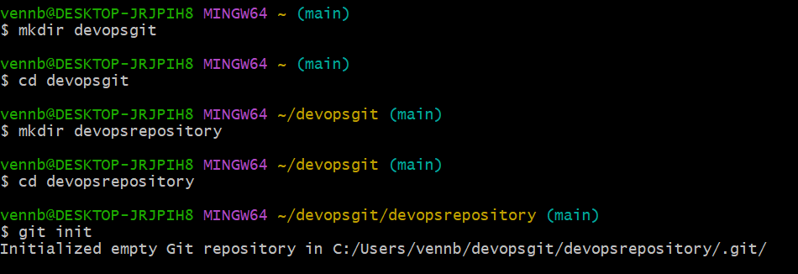
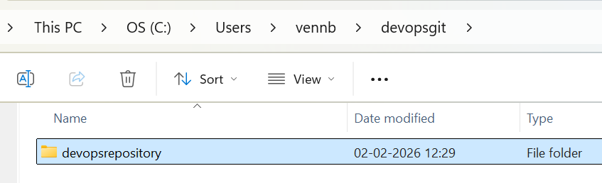
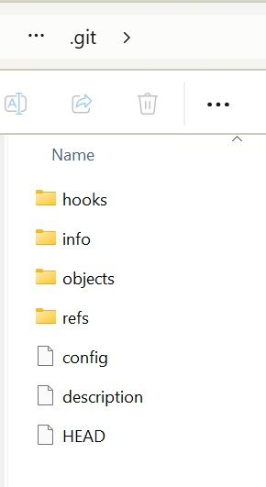
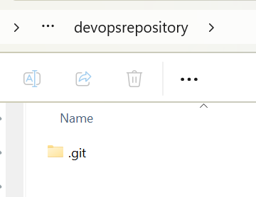
Create a folder & repository

Slide 38
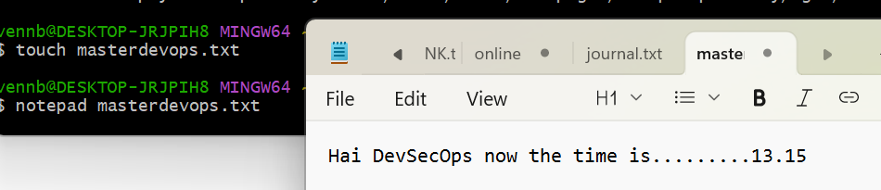
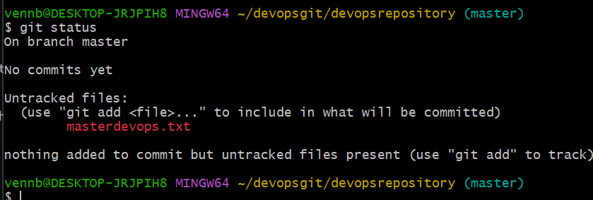
Untracked : Creating a new file
The touch command is used to change file timestamps or create an empty file if it doesn't exist. It's often used to create placeholder files or update timestamps for build systems.
Git status
Still untracked

Slide 39
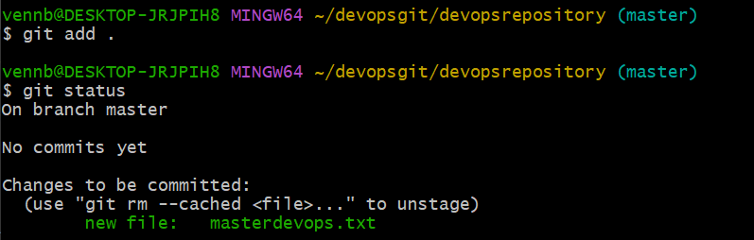
Staged → git add .
Added to repository –color changed from RED to GREEN

Slide 40
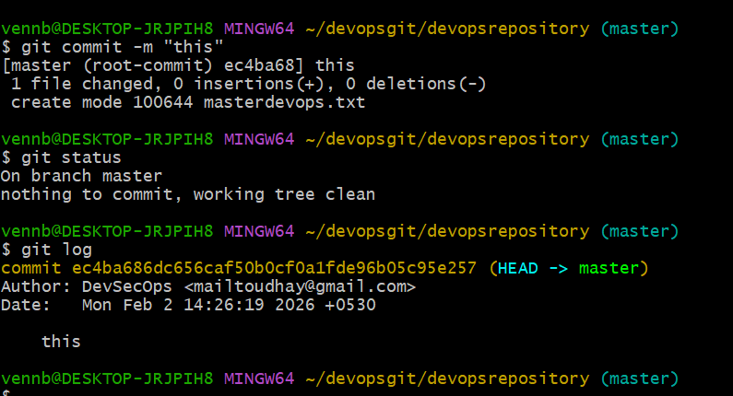
Committed → git commit –m “this”

Slide 41
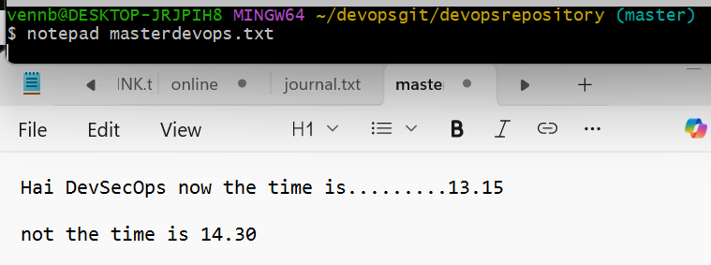
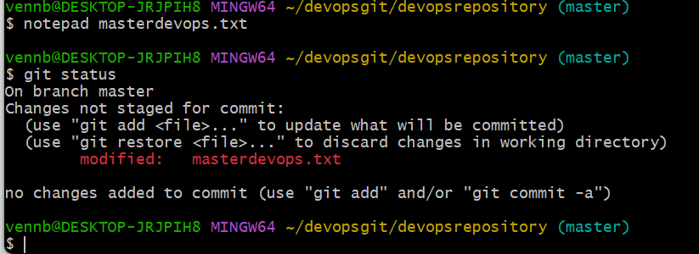
Modified

Slide 42
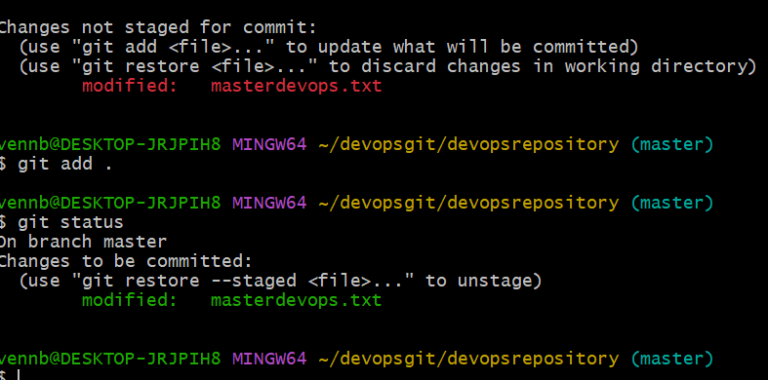
Modified – Stage file for commit

Slide 43
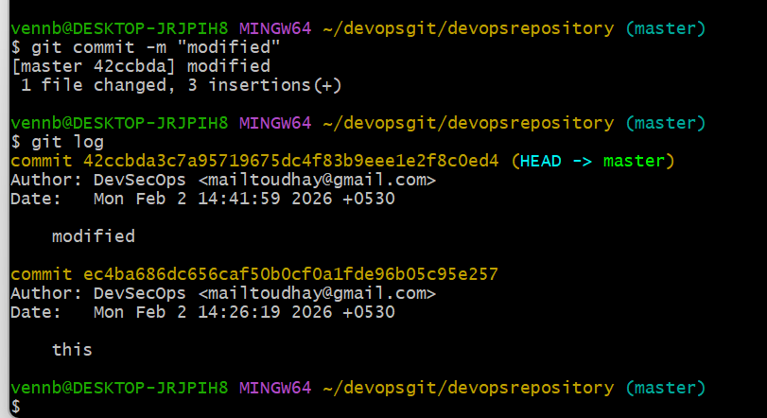
Modified Status check (git commit –m “modified”)

Slide 44
Summary

Slide 45
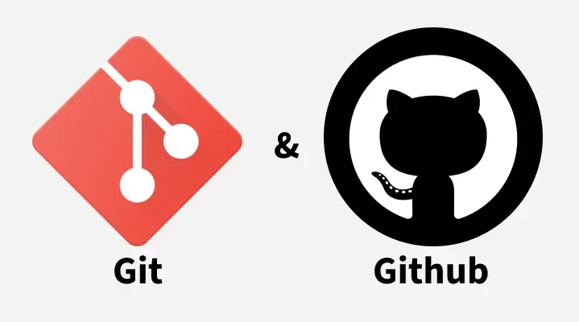
Remote Repositories

Slide 46
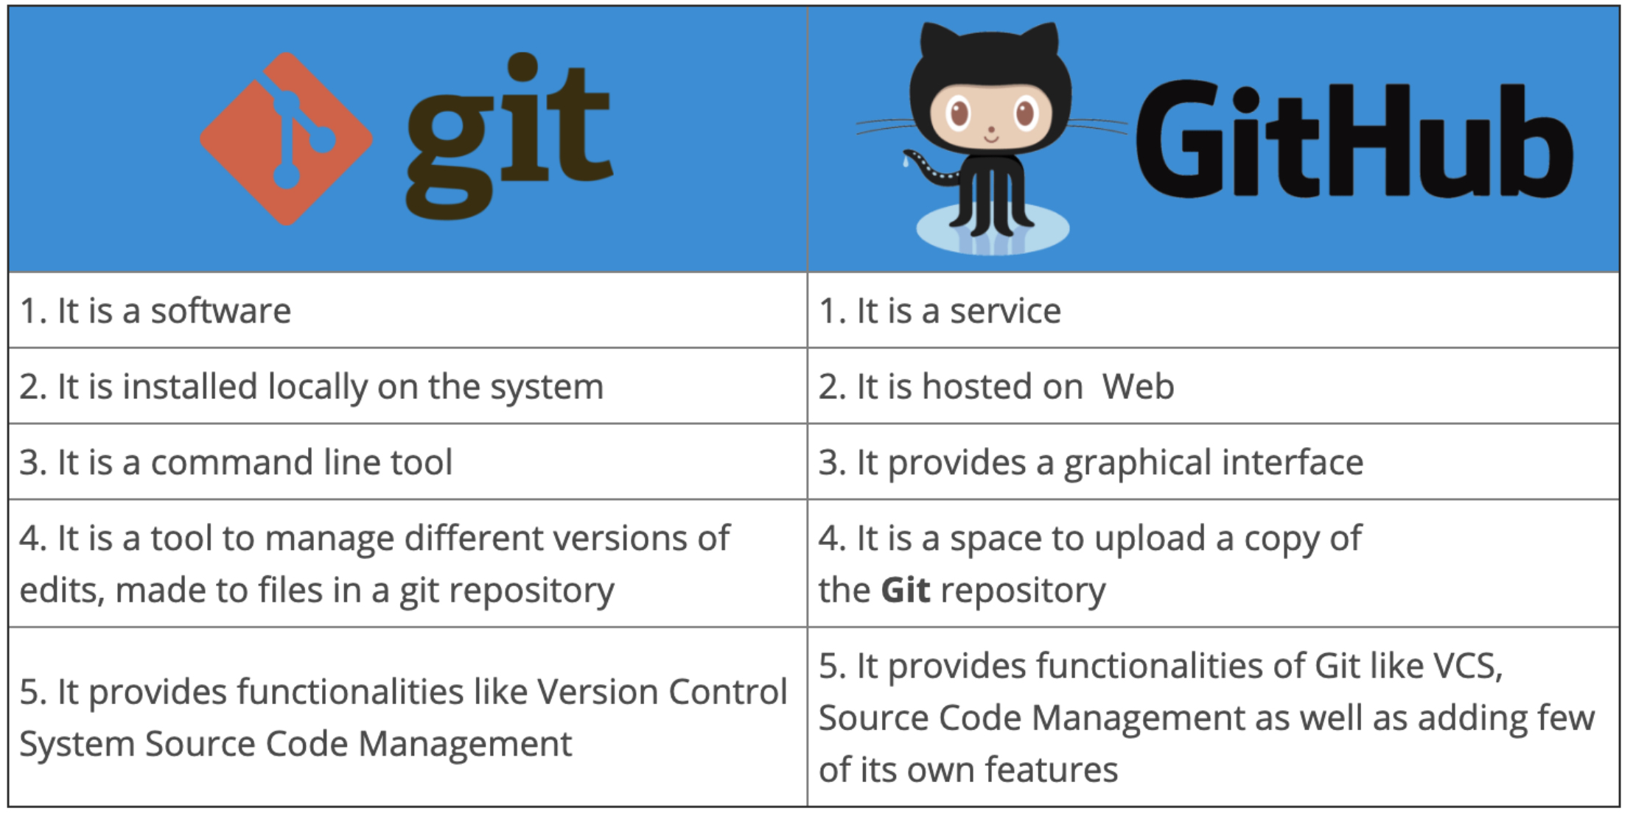
Github
A remote repository is a version of your project hosted on the internet.

Slide 47
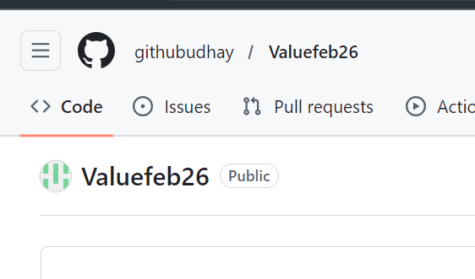
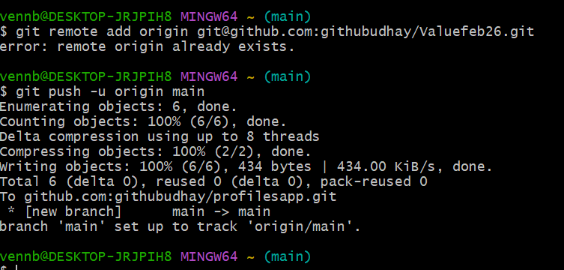
Creating a repository
git@github.com:githubudhay/Valuefeb26.git

